Slide 1
Expectation Maximization(EM) with Bernoulli Distribution

Slide 2
What is EM?
It is a general framework used whenever a model has hidden (latent) variables.
EM is used when:
Model has hidden variables Direct MLE(Maximum Likelihood Estimation) is difficult Data is incomplete or uncertain
Iterative: E-step and M-step

Slide 3
Bernoulli Distribution
Used for binary data (0/1)
P(x|θ)=θ^x (1-θ)^(1-x)

Slide 4
Model Assumption
Data from mixture of Bernoulli distributions
Each cluster has its own θ

Slide 5
Hidden Variable
Cluster label Zi is unknown
We estimate it using probabilities
Assigning a data point to a cluster in EM corresponds to estimating hidden variables, but instead of hard assignment, EM computes probabilistic (soft) assignments using responsibilities.

Slide 6
E-Step
Compute responsibility r_ik
Probability point belongs to cluster k

Slide 7
M-Step
Update parameters:
θ_k = Σ(r_ik * x_i) / Σ(r_ik)
π_k = Σr_ik / N

Slide 8
Responsibility Concept
Soft assignment
Values between 0 and 1

Slide 9
Iteration Process
Initialize parameters
Repeat E-step and M-step
Until convergence

Slide 10
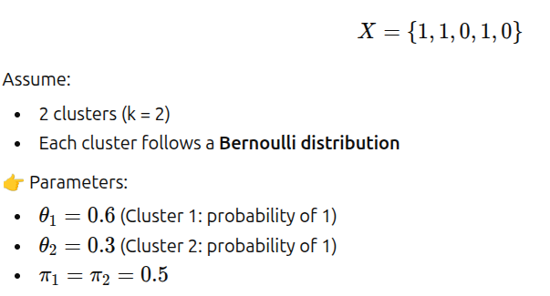
Example

Slide 11
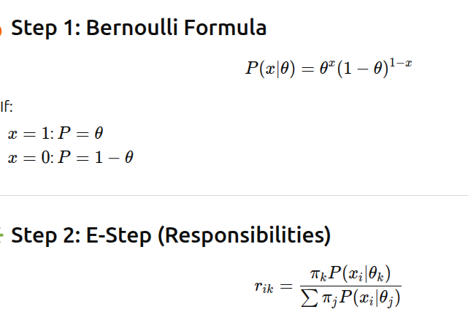

Slide 12
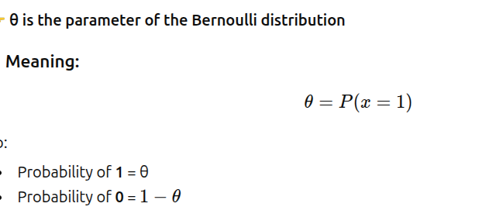
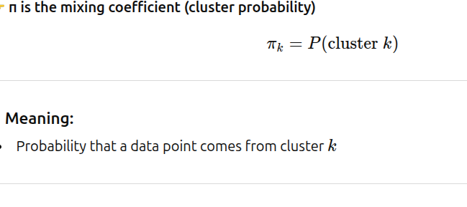

Slide 13
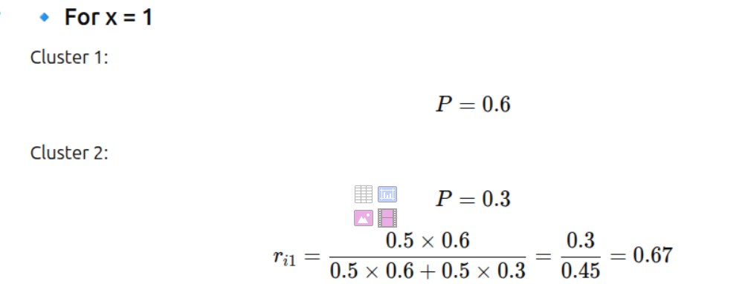

Slide 14



Slide 15
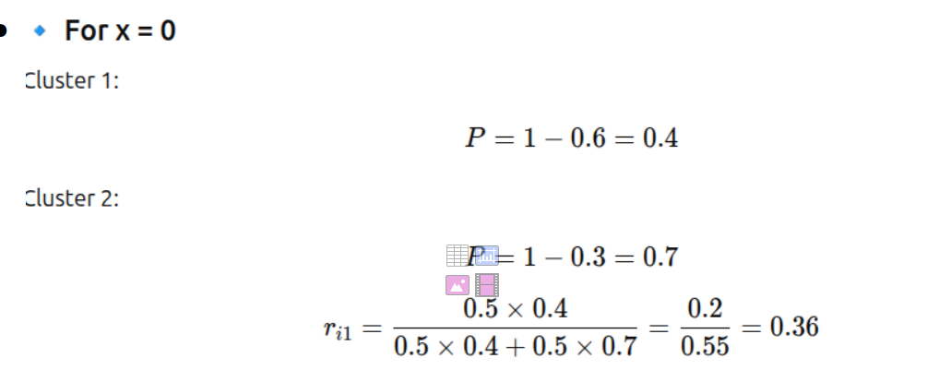

Slide 16



Slide 17
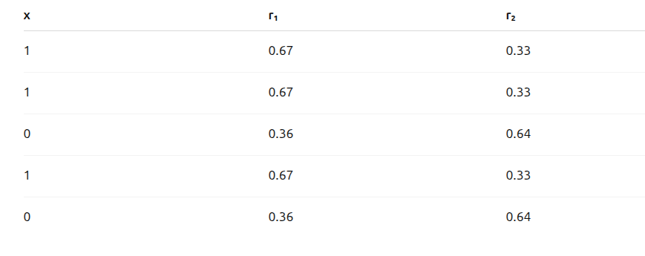
Responsibility Table

Slide 18
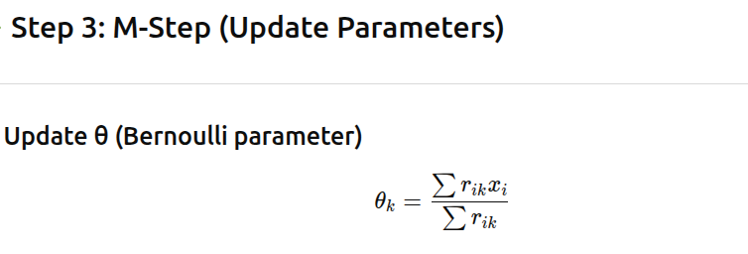

Slide 19
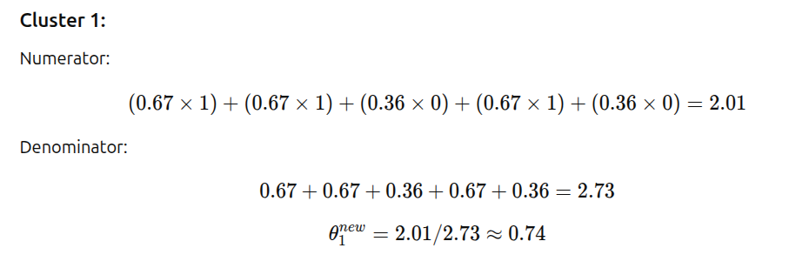

Slide 20
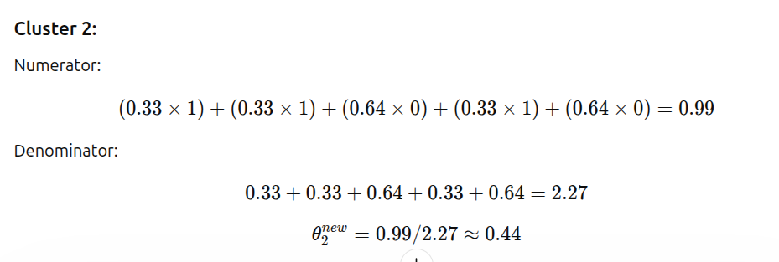

Slide 21
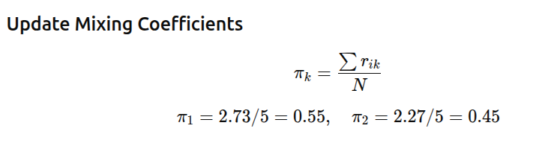

Slide 22

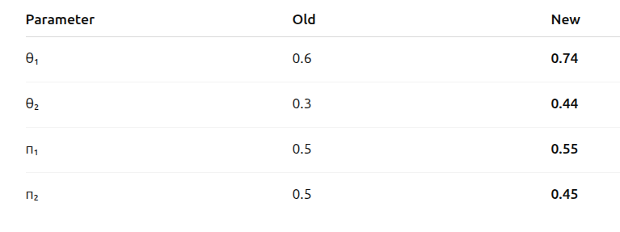
Final Parameters (After Iteration 1)

Slide 23

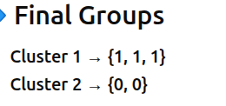
Assigning a data point to a cluster in EM corresponds to estimating hidden variables, but instead of hard assignment, EM computes probabilistic (soft) assignments using responsibilities.
(Note: Iterations will be continued. Above steps are for iteration 1, Based on new parameters iterations can be continued..)

Slide 24
Advantages
Handles binary data
Probabilistic clustering

Slide 25
Applications
Document classification
Survey data
Binary feature clustering

